Slide 1

CS 533 INTRO TO DATA SCIENCE
Michael Ekstrand

Slide 2
JOINT, CONDITIONAL, AND MARGINAL PROBABILITY

Slide 3
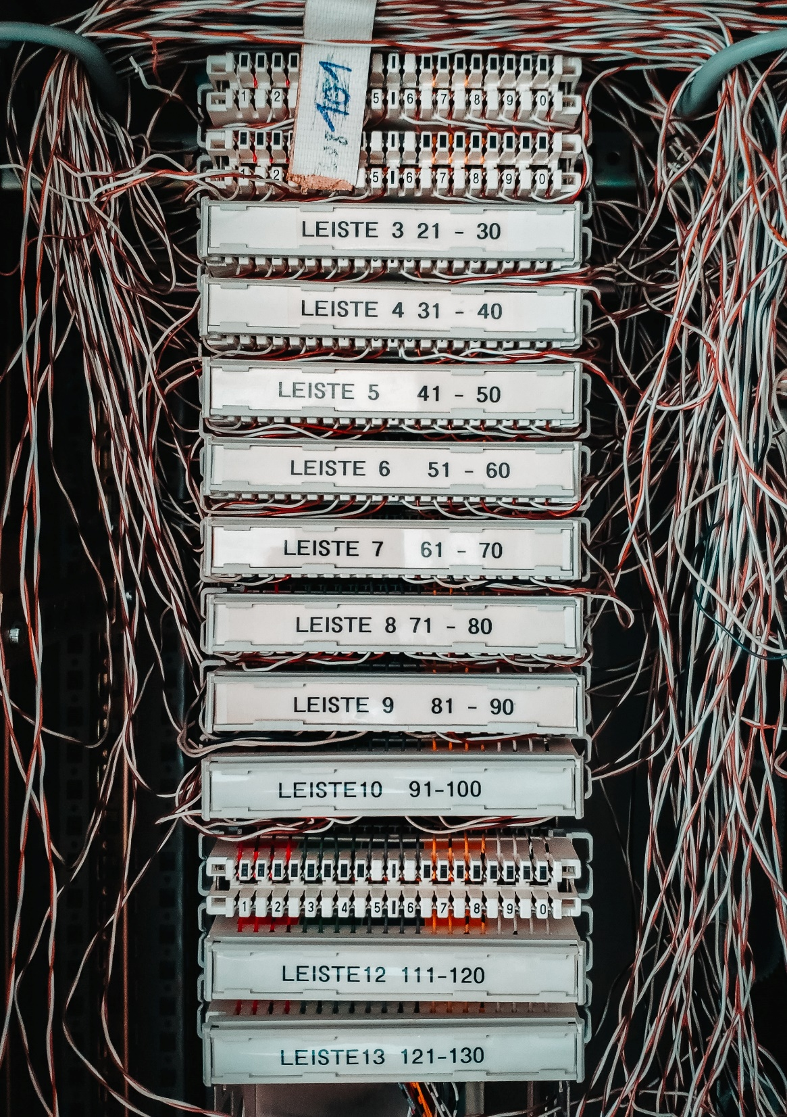
Learning Outcomes
Understand the definitions of and relationship between joint, conditional, and marginal probability
Apply Bayes’ theorem to invert a conditional probability
Describe what it means for two variables to be independent
Photo by Mika Baumeister on Unsplash

Slide 4
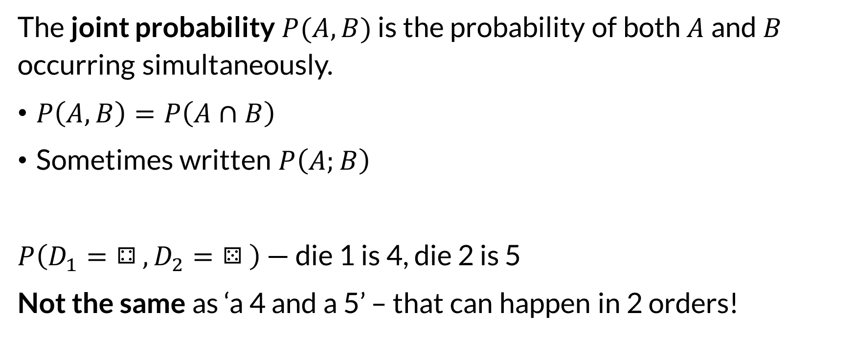

Joint Probability
The joint probability $P(A,B)$ is the probability of both $A$ and $B$ occurring simultaneously.
$P\left(A,B\right)=P\left(A∩B\right)$
Sometimes written $P\left(A;B\right)$
$P\left(D_{1}=⚃,D_{2}=⚄\right)$ — die 1 is 4, die 2 is 5
Not the same as ‘a 4 and a 5’ – that can happen in 2 orders!

Slide 5
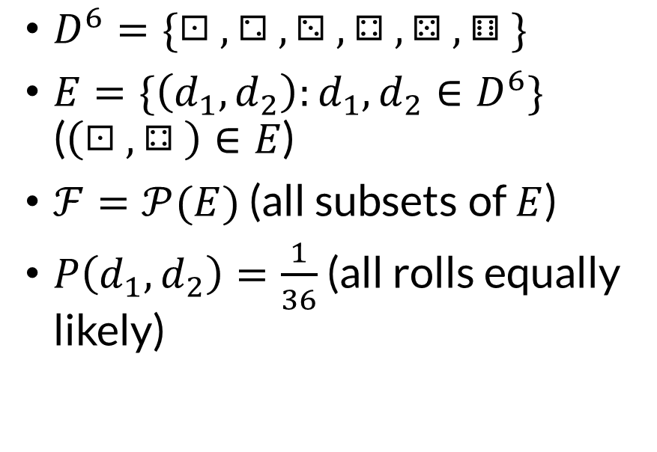
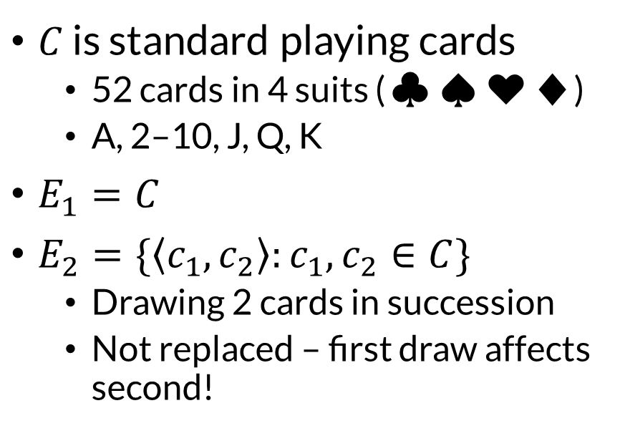
Two-Dimensional Spaces
Dice
Cards
$D^{6}=\{⚀,⚁,⚂,⚃,⚄,⚅\}$
$E=\{\left(d_{1},d_{2}\right):d_{1},d_{2}∈D^{6}\}$ ($\left(⚀,⚃\right)∈E$)
$ℱ=𝒫(E)$ (all subsets of $E$)
$P\left(d_{1},d_{2}\right)=\frac{1}{36}$ (all rolls equally likely)
$C$ is standard playing cards
52 cards in 4 suits (♣♠♥♦️)
A, 2–10, J, Q, K
$E_{1}=C$
$E_{2}=\{\left\langle c_{1},c_{2}\right\rangle :c_{1},c_{2}∈C\}$
Drawing 2 cards in succession
Not replaced – first draw affects second!

Slide 6
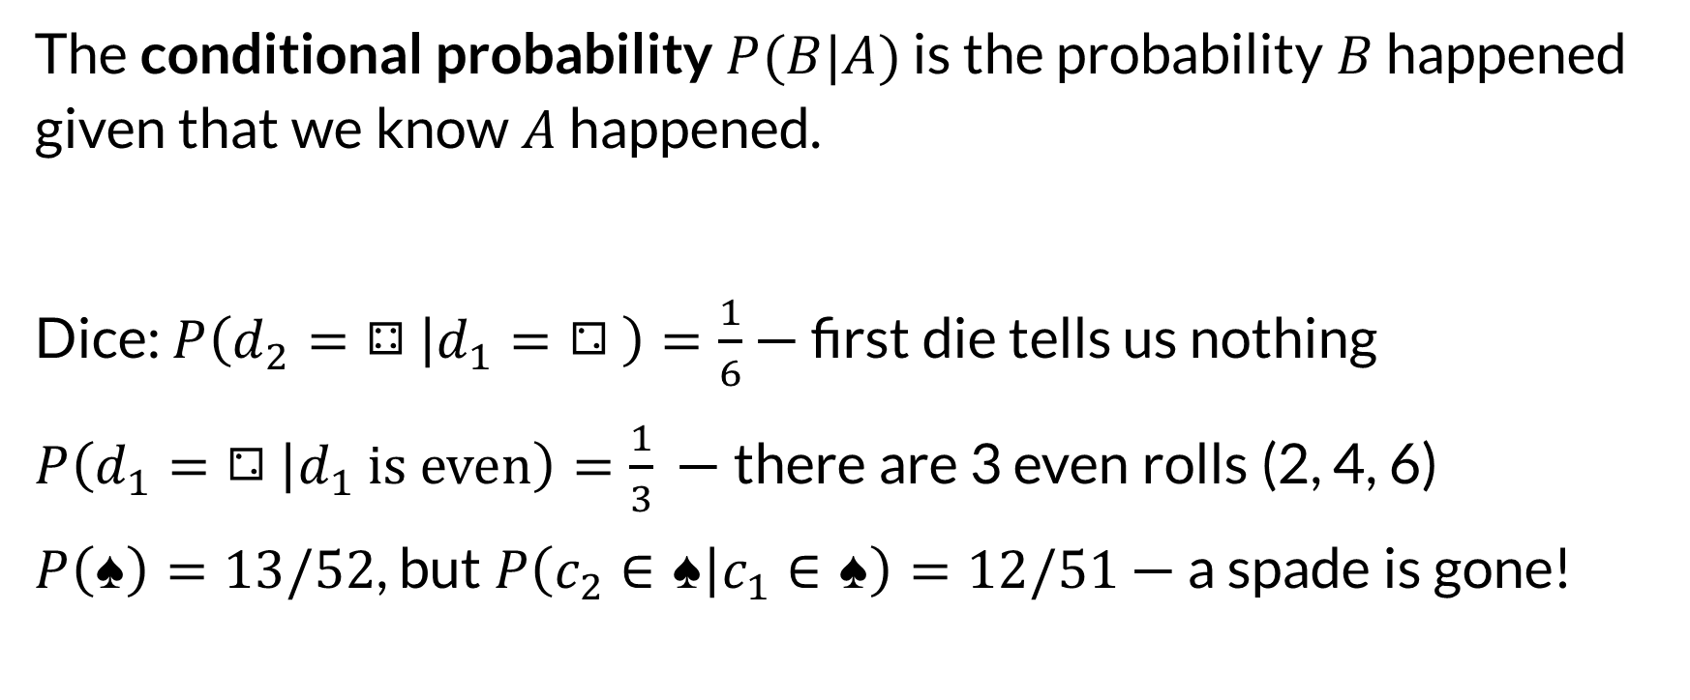
Conditional Probability
The conditional probability $P(B|A)$ is the probability $B$ happened given that we know $A$ happened.
Dice: $P\left(d_{2}=⚃ | d_{1}=⚁\right)=\frac{1}{6}$ — first die tells us nothing
$P\left(d_{1}=⚁ | d_{1} is even\right)=\frac{1}{3}$ — there are 3 even rolls (2, 4, 6)
$P\left(♠\right)=13/52$, but $P\left(c_{2}∈♠ | c_{1}∈♠\right)=12/51$ — a spade is gone!

Slide 7

Conditional and Joint
We can decompose joint probabilities into conditional:
$$P\left(A,B\right)=P\left(A | B\right)P\left(B\right)=P\left(B | A\right)P(A)$$

Slide 8
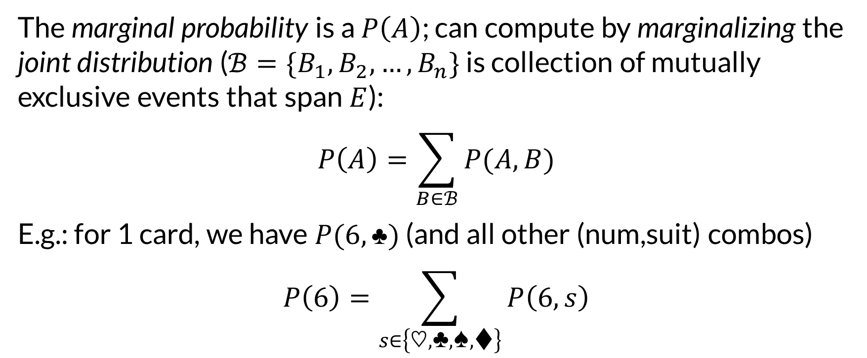

Marginal Probability
The marginal probability is a $P\left(A\right)$; can compute by marginalizing the joint distribution ($ℬ=\{B_{1},B_{2},…,B_{n}\}$ is collection of mutually exclusive events that span $E$):
$$P\left(A\right)=\sum_{B∈ℬ}{P(A,B)}$$
E.g.: for 1 card, we have $P(6,♣)$ (and all other (num,suit) combos)
$$P\left(6\right)=\sum_{s∈\left\{♡,♣️,♠️,♦️\right\}}{P\left(6,s\right)}$$

Slide 9
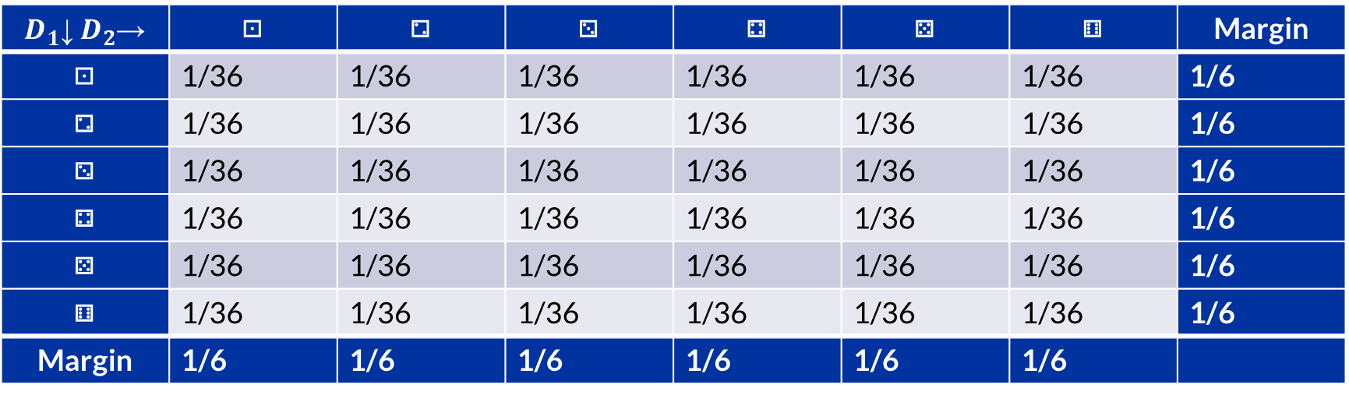

Marginalization
$D_{1}$↓ $D_{2}$→ | ⚀ | ⚁ | ⚂ | ⚃ | ⚄ | ⚅ | Margin
⚀ | 1/36 | 1/36 | 1/36 | 1/36 | 1/36 | 1/36 | 1/6
⚁ | 1/36 | 1/36 | 1/36 | 1/36 | 1/36 | 1/36 | 1/6
⚂ | 1/36 | 1/36 | 1/36 | 1/36 | 1/36 | 1/36 | 1/6
⚃ | 1/36 | 1/36 | 1/36 | 1/36 | 1/36 | 1/36 | 1/6
⚄ | 1/36 | 1/36 | 1/36 | 1/36 | 1/36 | 1/36 | 1/6
⚅ | 1/36 | 1/36 | 1/36 | 1/36 | 1/36 | 1/36 | 1/6
Margin | 1/6 | 1/6 | 1/6 | 1/6 | 1/6 | 1/6

Slide 10
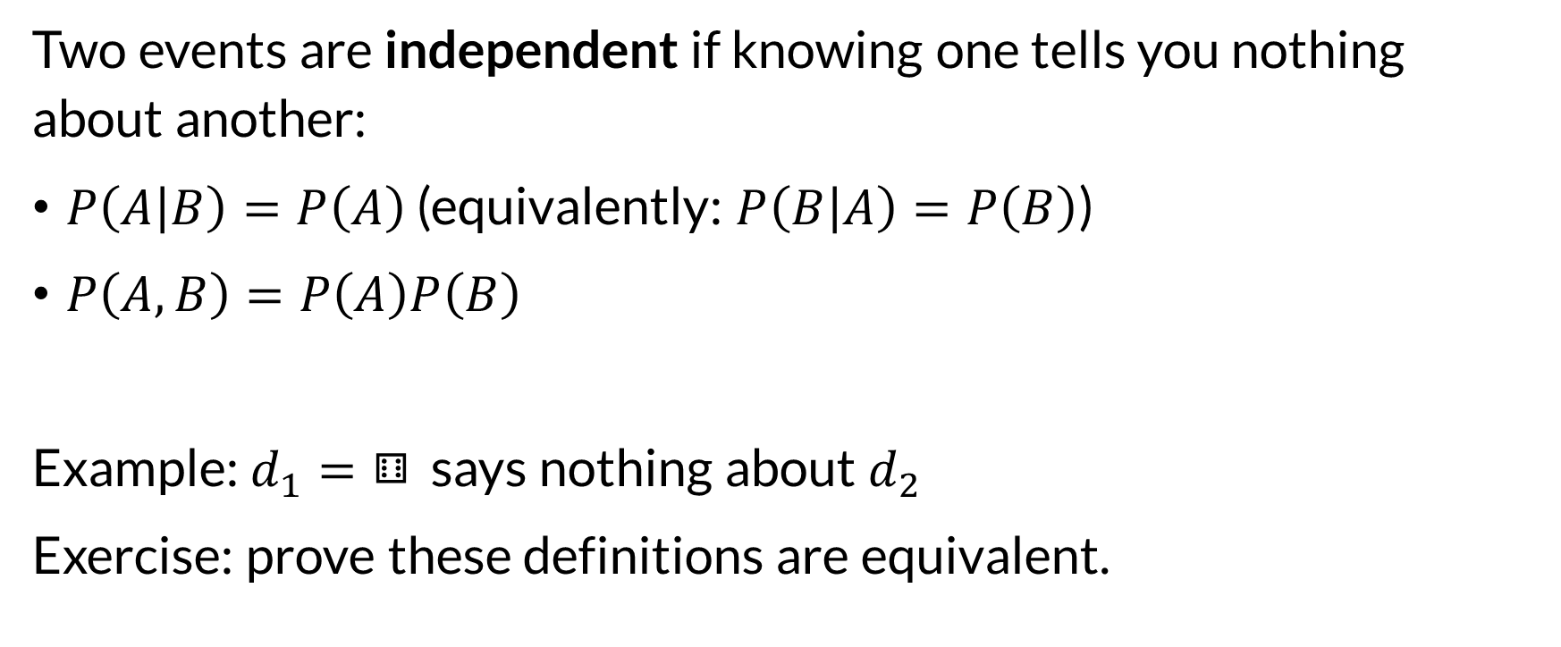
Independence
Two events are independent if knowing one tells you nothing about another:
$P\left(A | B\right)=P\left(A\right)$ (equivalently: $P\left(B | A\right)=P\left(B\right)$)
$P\left(A,B\right)=P\left(A\right)P\left(B\right)$
Example: $d_{1}=⚅$ says nothing about $d_{2}$
Exercise: prove these definitions are equivalent.

Slide 11
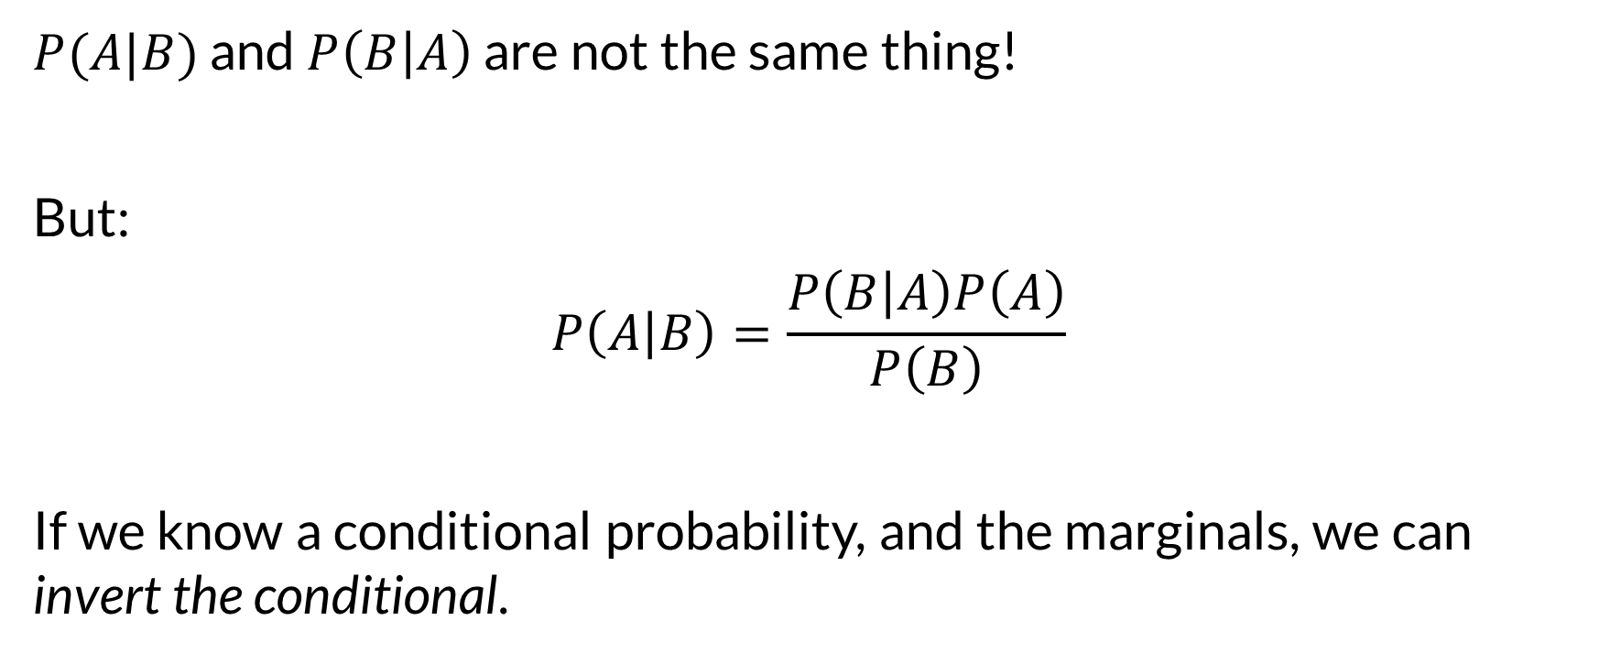
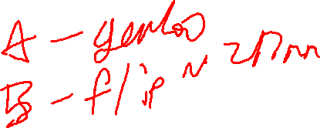
Bayes’ Theorem
$P(A|B)$ and $P\left(B | A\right)$ are not the same thing!
But:
$$P\left(A | B\right)=\frac{P\left(B | A\right)P\left(A\right)}{P\left(B\right)}$$
If we know a conditional probability, and the marginals, we can invert the conditional.

Slide 12

Wrapping Up
Joint probability: multiple events.
Conditional probability describes an event conditioned on other information.
These are building blocks for more reasoning. We will use them a lot.
Photo by Mika Baumeister on Unsplash

